Slide 1

IoT System for pH Monitoring in Manufacturing Facilities
Instituto Superior de Engenharia de Lisboa (ISEL)
Engenharia Informática e Computadores (LEIC)

Slide 2
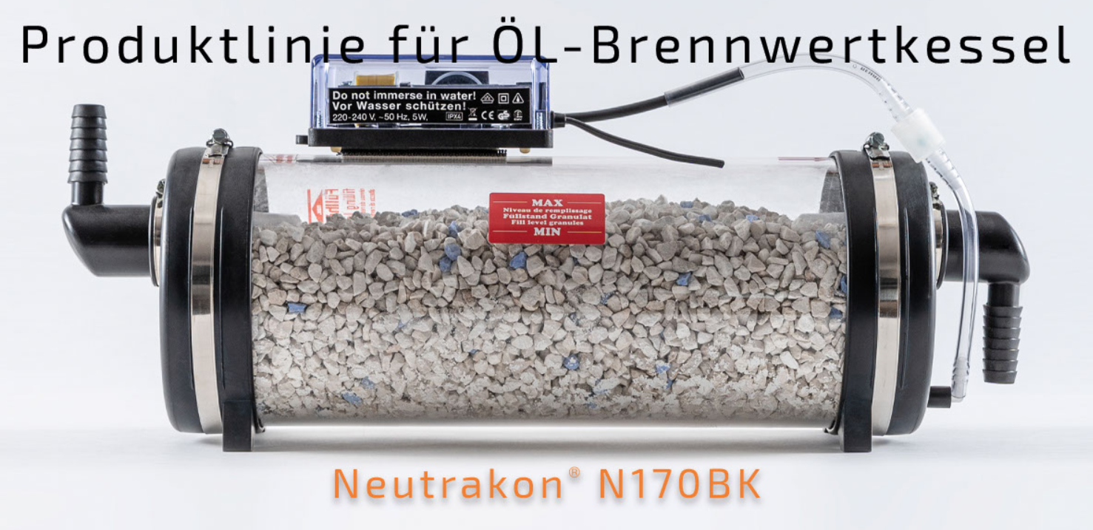
Water Filter
Neutrakon® 05 /BGN Caldeira de condensação até 55 kW

Slide 3
Requirements
Economic Hardware
High battery life device
Low false alarm frequency
Visual alarm
Hardware documentation

Slide 4
Main Objectives
Programming the MCU to collect and send data
Setting the message broker
Implementing the back-end service to manage system logic (data analysis and alert system)
Implementing the database to store system data
Implementing a user-friendly interface to interact with the system (visualize data, adding devices, etc)

Slide 5
Optional Objectives
Android App to interact with the system
Additional sensors, to collect more data, from the system
AI algorithm to improve the quality of collected data

Slide 6
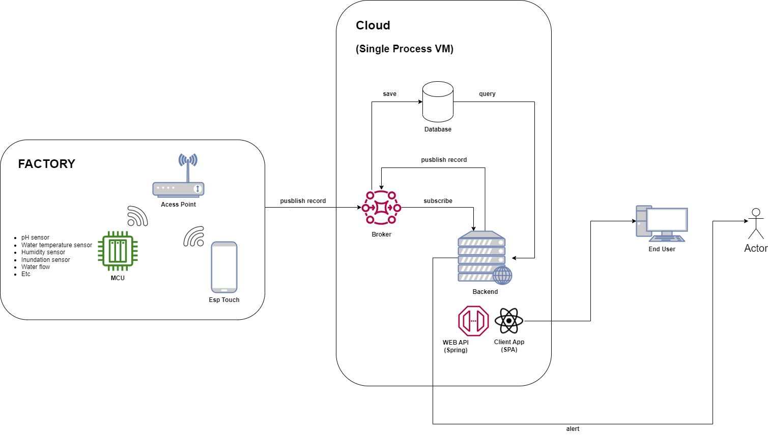
System Architecture
Hardware
Sensors
ESP32-S2
Access Point
IoT platform
Broker
Database
Backend - REST API
Frontend
Web App
Android App (optional)

Slide 7
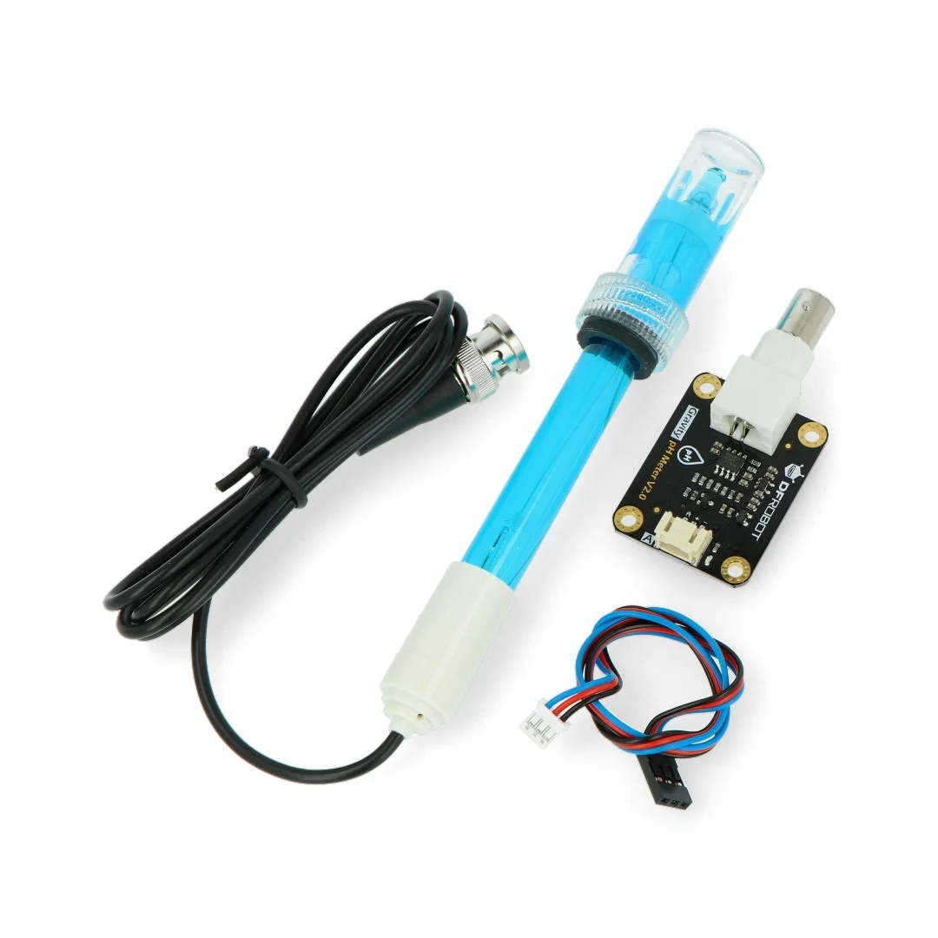
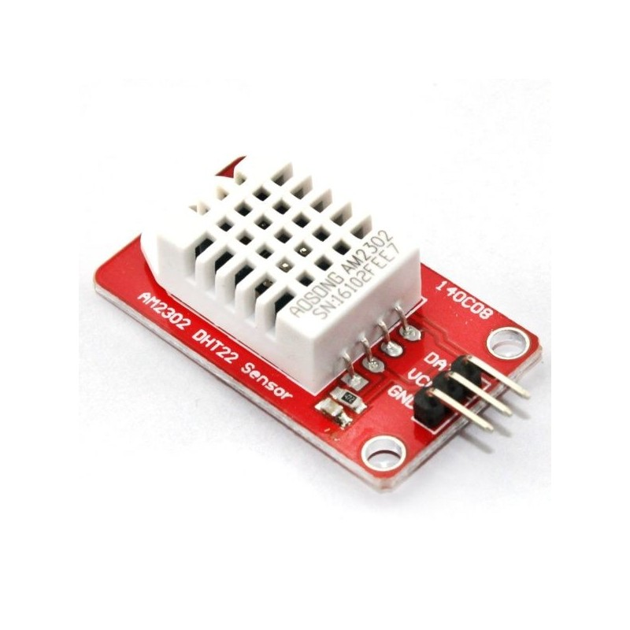
Sensors
Humidity and temperature ambient
pH sensors (beggining and end of filter)
Inundation sensor
Water flow

Slide 8
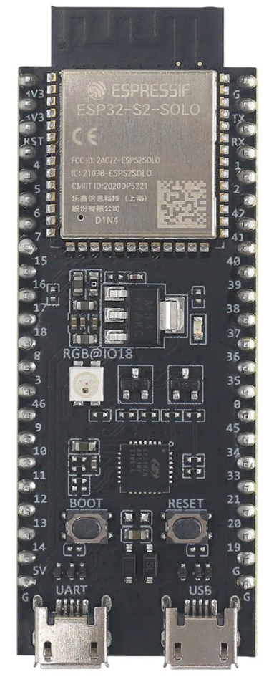

Board – ESP32-S2
Wi-Fi
Low Power Mode
43 GPIO
Single Core 240 MHz
7.62€ (Mouser online store)
Coded with ESP-IDF framework

Slide 9




IoT Platform
Postgres SQL -> Database
Kotlin -> Backend
Spring Boot framework -> Backend
HiveMQ CE -> Broker

Slide 10



Frontend
React -> Web App
React Bootstrap -> Web App
Android (optional) -> Android App

Slide 11
Justification
Better understanding of the IoT technology
Increase in hardware programming skill
Use of alternative network protocols
Further our understanding of various topics covered during our academic course:
Web programming
Database design and implementation
Android programming (optional)
Skill gain in architectural design of a medium scale project (software + hardware)

Slide 12
Scope
Notification systems to alert the admin/manager of a possible filtration system malfunction
Associate/remove IoT devices to/from the IoT platform
Having the ability to visualize collected data, in a graph form
System thresholds configuration (PH or/and water temperature critical level)

Slide 13
Constraints and assumptions
Limited hardware programming experience
Low experience programming MCUs
New to IoT technology and platforms
New to alternative network protocols (other than HTTP)
Hardware has to be possible to acquire in timely manner

Slide 14



Project Organization
Team
Pedro Silva
Miguel Rocha
Guide
Rui Duarte
Company
Mommertz (located in Germany)
Platform management:
Basecamp
GitHub

Slide 15
Major Milestones
20 Mar. 2023
Project Proposal
24 Apr. 2023
Progress presentation
5 June 2023
Beta version (report, poster, and organization)
10 July 2023
Final version (Academic Calendar 2022/2023)

Slide 16
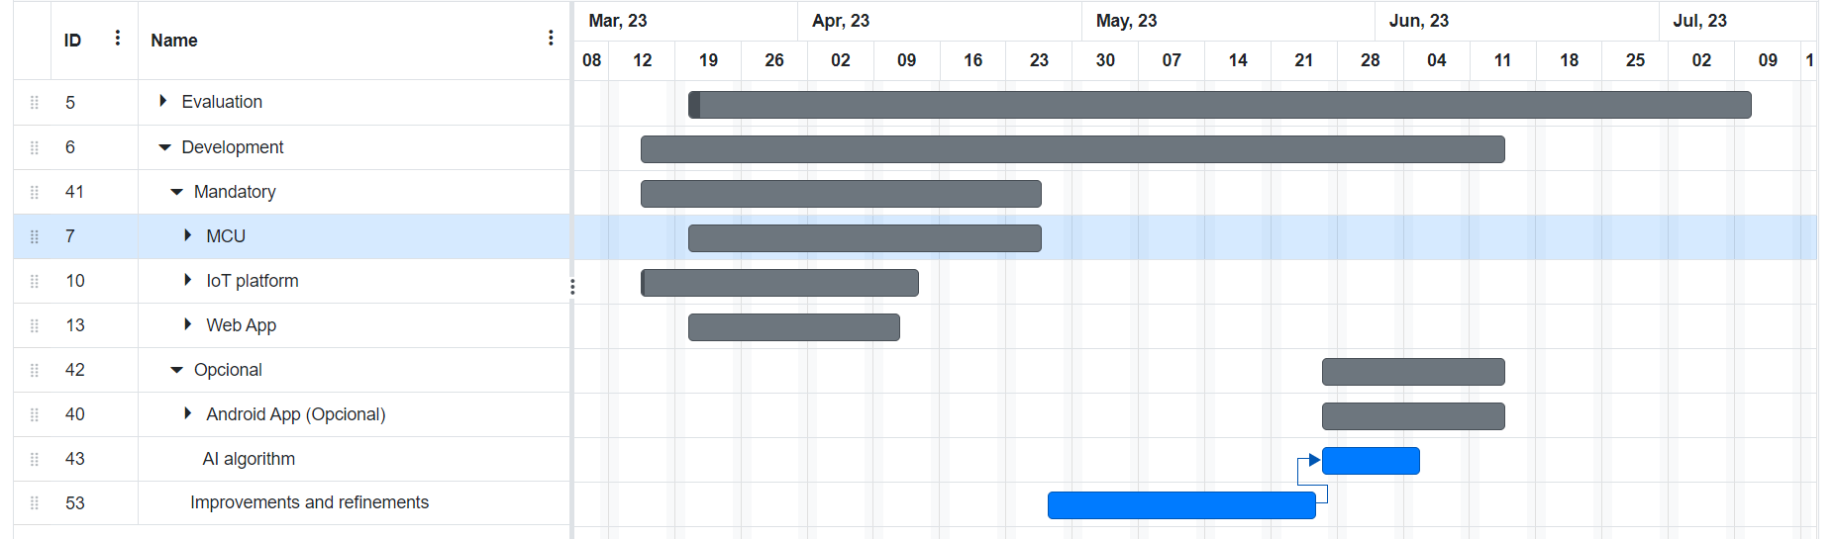
Gantt

Slide 17
Bibliography
https://mommertz.de/neutralisation-oel-bwk.html
https://botland.store/gravity-temperature-sensors/15094-gravity-ph-analog-sensormeter-v2-dfrobot-sen0161-v2-5904422342920.html
https://www.electrofun.pt/sensores-arduino/sensor-humidade-temperatura-dht22-am2302-modulo?utm_campaign=efshopping&utm_source=google&utm_medium=cpc&utm_source=google&utm_medium=shopping&utm_campaign=roas&gclid=CjwKCAjw5dqgBhBNEiwA7PryaNJvTICP7r6IVvm_VTUBhN60vsUV195PoVzG8gtCwhgmIQjtwREtyhoCotUQAvD_BwE

Slide 18
Bibliography
https://pt.mouser.com/ProductDetail/Espressif-Systems/ESP32-S2-DevKitC-1U?qs=pBJMDPsKWf0y5luJFio6Ng%3D%3D
https://www.google.com/search?q=espressif+idf&rlz=1C1FCXM_pt-PTPT1045PT1045&sxsrf=AJOqlzWG8QtYywWcD9jUsnxLutr3o13HVw:1679256691016&source=lnms&tbm=isch&sa=X&ved=2ahUKEwji47fU5uj9AhVicKQEHRf5D9cQ_AUoAXoECAEQAw&biw=1536&bih=714&dpr=1.25#imgrc=iaGd5y6o3iDlzM&imgdii=FyR0RU9LwaPsiM

Slide 19
Bibliography
https://docs.espressif.com/projects/esp-idf/en/latest/esp32/about.html
https://www.interviewbit.com/blog/spring-vs-spring-boot/
https://www.pngwing.com/en/free-png-nlelb
https://www.hivemq.com/developers/community/
https://www.pngwing.com/en/free-png-aglpc
https://react-bootstrap.github.io/

Slide 20
Bibliography
https://pt.wikipedia.org/wiki/Ficheiro:Android_logo_2019_%28stacked%29.svg
https://pt.m.wikipedia.org/wiki/Ficheiro:Kotlin_logo.svg
https://mommertz.de/
https://salesdorado.com/pt-br/automacao/ferramentas-gerenciamento-projetos/avis-basecamp/
https://1000logos.net/github-logo/

